Slide 1







Welcome to
FREEDOM FINANCIAL
In business for yourself, but not by yourself.

Slide 2




AGENDA
AGENDA
Who We Are
01
How You Make Money
04
What We Do
02
Who Else Is Doing It
05
How the System Works
03
Your Next Steps
06

Slide 3






WHO WE ARE

Slide 4





WHAT DO WE DO?
01
We help families with LIFE INSURANCE and ANNUITIES
02
We teach you how to BUILD A BUSINESS OF AGENTS who do the same

Slide 5

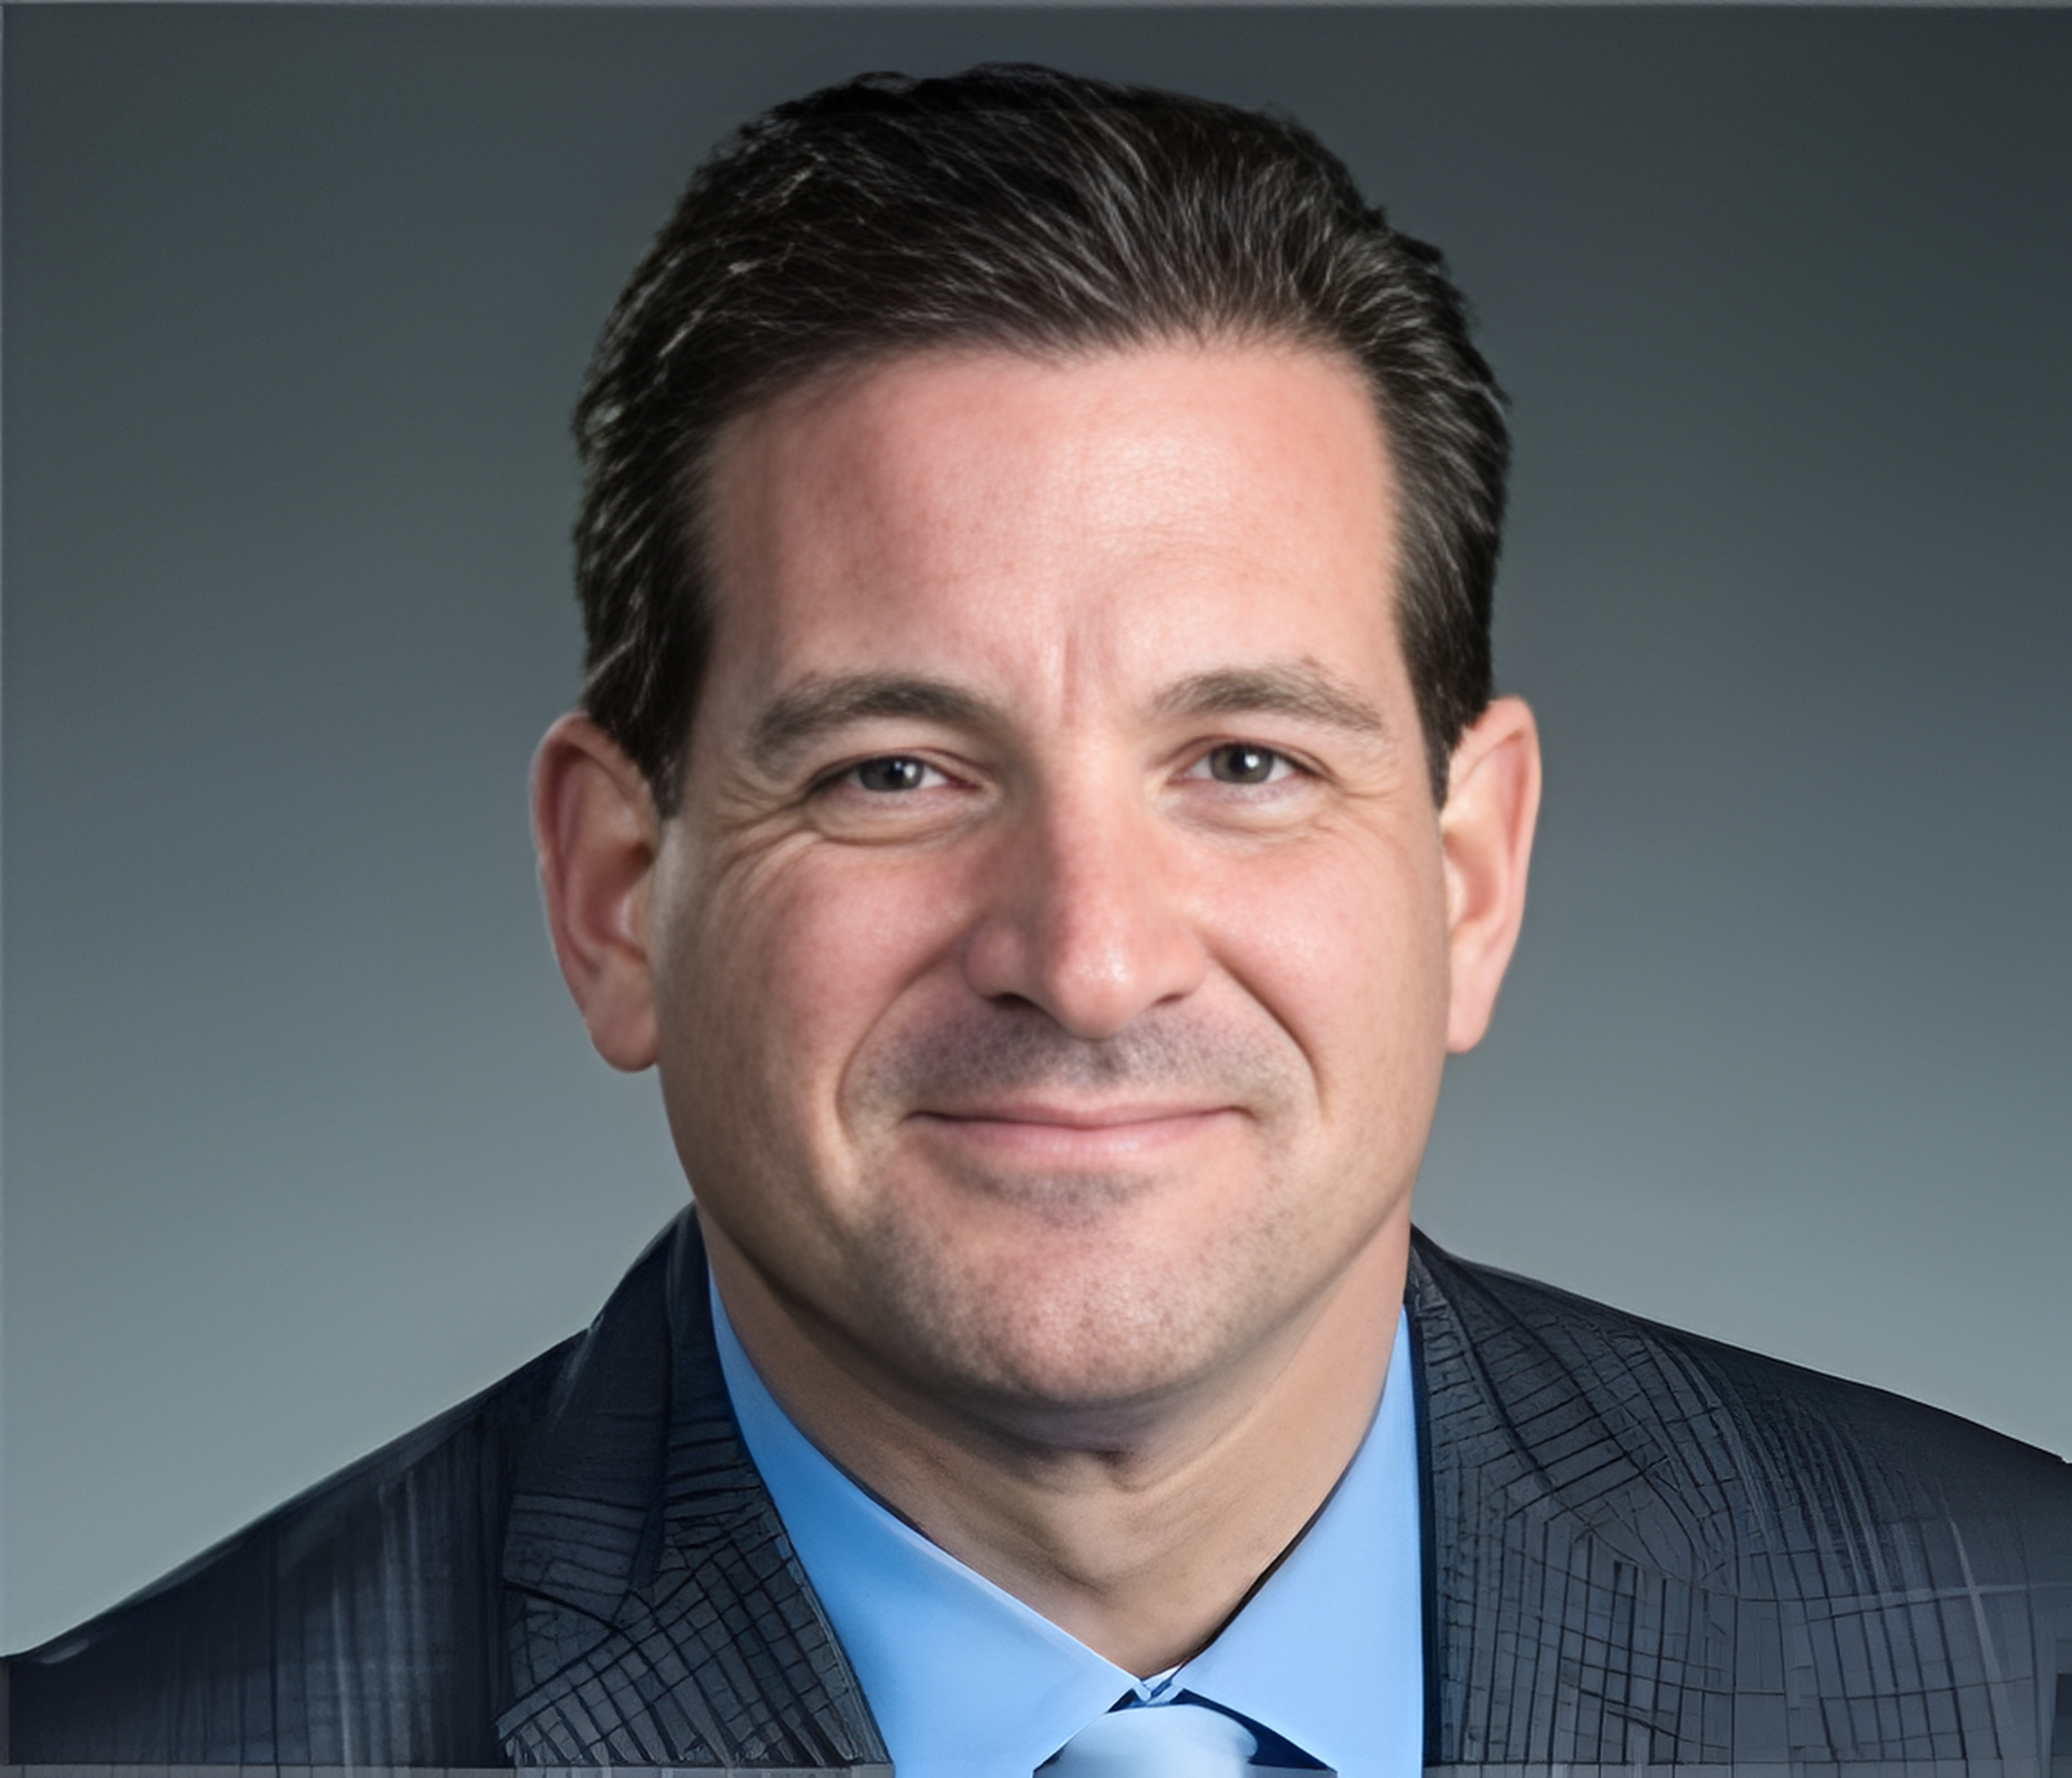

OUR CEO:
Robert Belcuore
OUR PARENT COMPANY:

Slide 6













AMERILIFE’S
TOP INSURANCE CARRIERS
Mutual of Omaha
Foresters
American Amicable
Transamerica
Corebridge
Royal Neighbors
American Home Life
Guarantee Trust Life

Slide 7






OUR MARKET
01
02
03
Baby Boomers
Uninsured Families
Recession-proof Industry
10,000 Baby Boomers retire daily, creating a steady demand for life insurance, annuities, and retirement planning—expected to continue for the next 15–20 years.
Over 60% of Americans don’t have enough life insurance to protect their families. This creates a major opportunity for agents.
Our strongest years were during COVID and economic downturns. People always need insurance and retirement solutions—
no matter the economy.

Slide 8







HOW THE SYSTEM WORKS
Leads
Leadership Development
Relationships
Training
We will train you so well you can go anywhere but we will love you so much you won’t want to.

Slide 9

HOW YOU MAKE MONEY

Slide 10

HOW YOU MAKE MONEY

Slide 11

HOW YOU MAKE MONEY

Slide 12

HOW YOU MAKE MONEY

Slide 13








WHO ELSE IS DOING IT
Grit
Moral compass
The ability to stay persistent and motivated, even when challenges get tough.
Consistently choosing to do what’s right, even without supervision.
HONOR.
ORDER.
AUTHORITY.
Accountability
Taking ownership of tasks, decisions, and outcomes—good or bad.
Coachability
The openness to receive feedback, learn quickly, and apply improvements.
Results-driven
Prioritizing impact and execution to turn goals into tangible outcomes.

Slide 14

YOUR NEXT STEPS:
01
Get a license
02
Follow up with one of our coaches
03
Start attending the trainings
04
Write down your dream and start dreaming

